Slide 1

Prediction of cancellation status of hotel bookings
INDIAN INSTITUTE OF INFORMATION TECHNOLOGY DESIGN AND MANUFACTURING, KURNOOL
by
G. Srikanth
119me0020

Slide 2
Problem statement
Cancelation status prediction for hotel bookings :
We should be able to determine whether a resident will cancel the reservation using the provided information on hotel bookings for a certain hotel. We can anticipate the cancellation status by implementing a binary classifier containing information on the lead time, agent, customer type, etc.
Type: Binary Classification type

Slide 3
Dataset Details
The dataset we utilise for this issue is called "hotel bookings". There are a huge number of observations, characteristics, and variables in this dataset. The dataset is 1,19,390*32 bytes in size. These have several datatypes. These are the different types of variables.
object – hotel, arrival_date_month, meal,country, market_segment,distribution_channel, reserved_room_type,assigned_room_type , deposit_type, customer_type, reservation_status, reservation_status_date .
float – adr, agent, company, chidren
int - is_canceled, lead_time, arrival_date_year, babies, is_repeated_guest, previous_cancellations, previous_bookings_not_canceled, booking_changes, days_in_waiting_list, required_car_parking_spaces, total_of_special_requests

Slide 4
Data Visualization
We can explore data in greater detail by visualising it. Different formats, including bar graphs, scatterplots, charting, pie charts, histograms, boxplots, and heatmaps, can be used to depict data.
In order to learn more about various factors, we used heatmaps, bar charts, and scatterplots to visualise data.
Heatmaps The null values in the data set are located using heatmaps. To locate columns that contain null values, in other words. From this graph, it was simple to eliminate the columns with the greatest number of null values. Additionally, confusion matrices and correlation matrices are displayed using heatmaps.
Scatter plot helps to show the relation between two variable.
Bar charts In relation to the categorical data in the data frame, bar charts are used to represent the dependent variable.

Slide 5
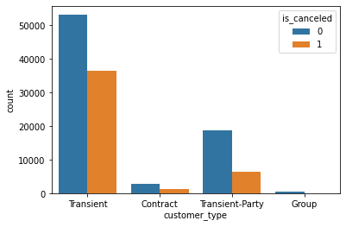
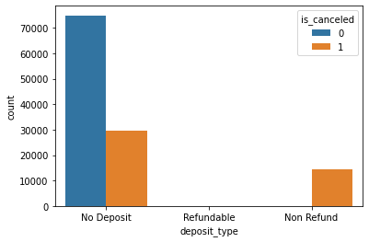
Data Visualization
figure1: Bar chart with customer_type on x-axis and
count of is_canceled on y-axis
figure2: Bar chart with deposit_type on x-axis and
count of is_canceled on y-axis

Slide 6
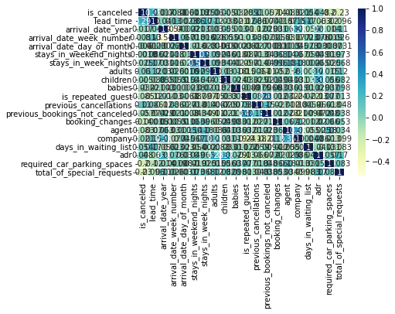
Data Visualization
Correlation Matrix:
It shows the relationship between each and every other variable.It varies from -1 to +1 as shown in the figure
fcorrelation matrix

Slide 7
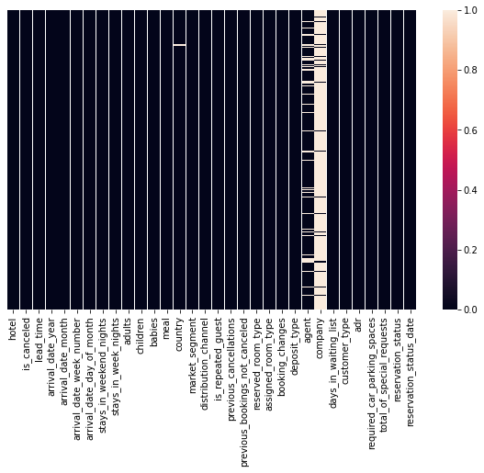
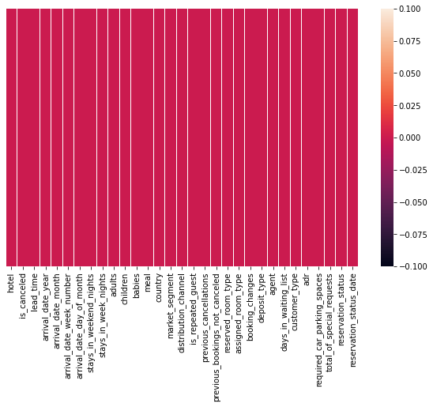
Data Visualization
figure5:heatmap showing white lines for null values.
figure6:heatmap after filling missing values

Slide 8
Procedure
Importing Libraries
The first step is to import all necessary libraries and models, including GaussianNB, DecisionTreeClassifier, RandomForestClassifier, GradientBoostingClassifier, KNN,AdaBoostClassifier, Matplotlib, Seaborn, Sklearn, train test split, LogesticRegression, SVC, confusion matrix, accuracy score, and LabelEncoder.

Slide 9
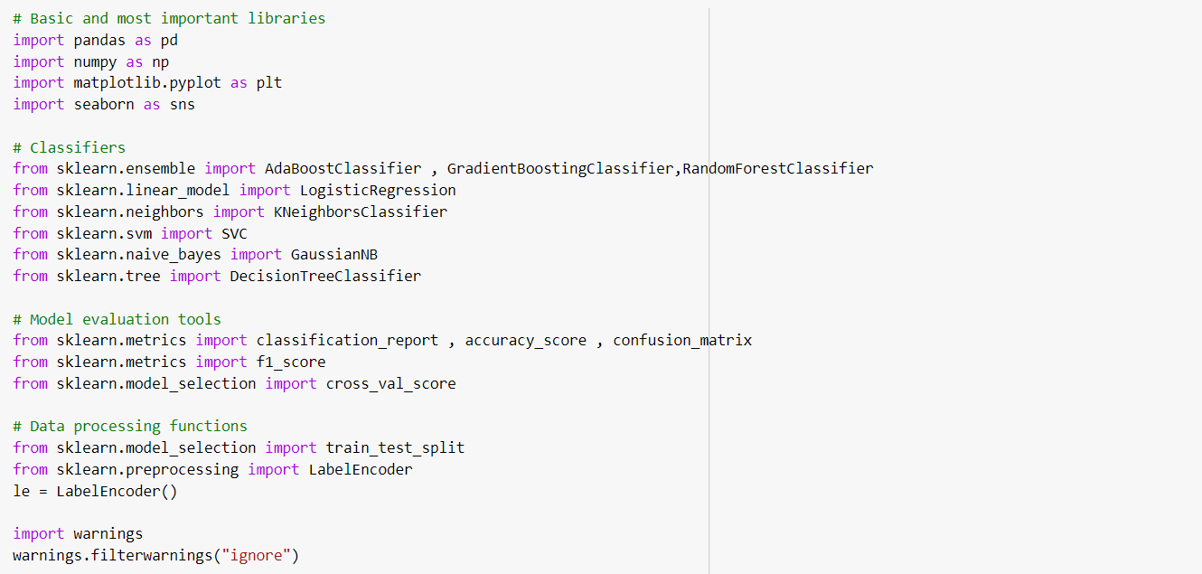
Procedure
figure7:importing libraries.

Slide 10
Procedure
Loading and Analyzing data
Using the pd.read CSV() command, a dataset is loaded into a variable (data) in the form of a dataframe.
Using procedures like data.shape, data.dtypes, data.describe(), and data.info, analyse the dataset's shape, datatypes, and statistical information ().

Slide 11
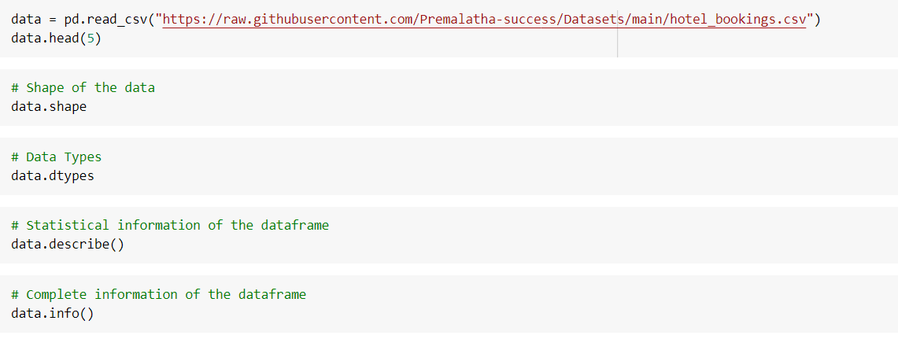
Procedure
figure8: Analyzing data

Slide 12
Procedure
Data Visualization
As I've already indicated in the previous presentations, this is a crucial phase in the implementation of a model.
We first draw a graph between the goal variable, is canceled, and categorial variables like customer type and deposit type.
In order to identify the variables that are most closely associated to one another, we then generate a heatmap graph for the correlation matrix of the provided dataset. To accomplish this, we use the sns.heatmap(data.corr()) command.
To uncover relationships between all of the numerical variables in the dataset, we finally create a pair plot.
In order to thoroughly analyse the data, several visualisation procedures are conducted before the implementation itself.

Slide 13
Procedure
Data Pre-processing
We must now clean the data before we can proceed to create a model. The treatment of missing data, duplicate data, noise, and outliers is a part of the data cleaning process.
We will locate the missing values in the provided dataset using a heatmap and the data.isnull().sum() method. Then, for numerical data, we will use the median to fill in the missing values, and for categorical data, we will use the mode. We employ the fillna() or replace() commands for it. Then, if necessary, we move on to eliminating duplicates and outliers.
After the cleaning procedure is finished, we use a heatmap to check if any missing values exist in the dataset.

Slide 14
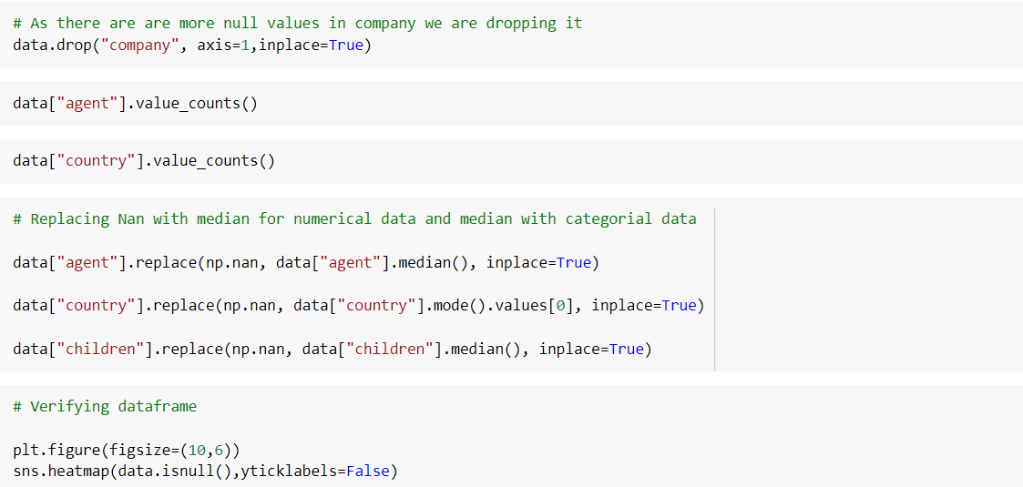
Procedure
figure9: Data Pre-processing

Slide 15
Procedure
Encoding Categorial Data
Following data pre-processing, the next step is to use the fit.transform() command to construct dummies for categorial data.
This step incorporates categorial data into the model to improve performance.
For the same purpose, we can also use the pd.get dummies() command.

Slide 16
Procedure
Splitting Data into Input X Variable and Target y variables
The data must now be divided in accordance with the problem statement. Is canceled should be divided into a target variable and a dependent y variable for this problem statement, and other independent variables should be divided into an input x variable..
Implementing Model
After all the other steps are finished, we must build the classifier models and select the one that best fits the data by utilising the score and accuracy parameter.

Slide 17
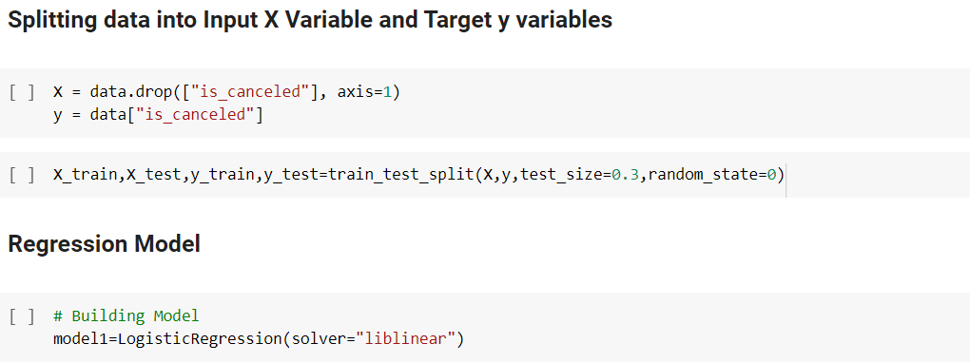
Procedure
figure11: Splitting and Creating model

Slide 18
Choosing Best fit Model
There are several binary classifier models we can use for this problem such as
Logistic Regression model
KNN Model
Decision Tree
Bagging Classifier
Adaboost Classifier
Gradient Boosting Classifier
Random Forest Classifier
Gaussian Naïve Bayes Model

Slide 19
Choosing Best fit Model
Logistic Regression We obtain a score of 0.9899967692915176 for the Logistic Regression model for the train set and 0.9891392355585337 for the test dataset. Despite the fact that it performs well, we should evaluate alternative models as well because it is a more effective model.
KNN model The accuracy for the KNN model is 0.8806153502526733; this is lower than the accuracy for the Logistic Regression Model.
Random Forest Classifier The Random Forest Classifier outperforms the KNN model and the Logistic Regression Model with a score of 0.9970125917860234.
Gaussian Naïve Bayes The score for the Gaussian Naive Bayes model is 0.9932155121869504, which is higher in comparison to all other classifiers.

Slide 20
Choosing Best fit Model
The best model out of all the others, Gradient Boosting Classifier, Bagging Classifier, Adaboost Classifier, and Decision Tree, gives a score of 1.0.
Best Fit Model: Decision Tree is my pick for the best fit model because it delivers a score of 1.0 and runs the programme faster than other models. This model has the fastest processing speed for very large datasets.

Slide 21
Conclusion
By evaluating each model against the provided problem statement. In my opinion, decision trees, bagging classifiers, adaboost classifiers, gradient boost classifiers, and classifiers are all 100% accurate.
The Random Forest Classifier then performs the classification task at its best. The Naive Bayes model then operates correctly.
SVM and Random Forest Classifier follow with the best performance. Last but not least, KNN performs the least among them. SVM takes longer than other programmes to compile than others.
Decision Tree, on the other hand, requires the least amount of time, which makes it the best model for this issue.

